Slide 1
How is Problem Gambling Impacting Urban
Aboriginal Peoples?
Cheryl L Currie, PhD (ABD)
School of Public Health, University of Alberta
AGRI Conference
April 8, 2011

Slide 2
Urban Aboriginal
Peoples in Canada
54% of Aboriginal Canadians live in cities
1 in 2 live below the poverty line in those cities
Young (28% under 15 years), mobile, more women
Education increasing - mostly apprenticeships/trades
Employment increasing
Edmonton - 2nd largest Aboriginal population (52,100)
Calgary – 26,500
Notes:
Many women are single parents moving with their children for better housing

Slide 3

Problem Gambling among
Urban Aboriginal Canadians
What is the extent of the problem?
How is problem gambling impacting this population?
Why is this population experiencing gambling problems?

Slide 4

Urban Aboriginal Study
Edmonton 2010
In-person surveys with Aboriginal (75%) and Métis (25%) peoples in Edmonton
381 adults from general population – volunteer sample
Recruitment: Ads in Aboriginal newspapers, posters, e-newsletter ads – examples:
  Native Friendship Centre, Indian Affairs at Canada Place, public libraries, public malls, Bissell Centre, training institutions (Norquest College)
  No ads at gaming establishments or treatment centres

Slide 5
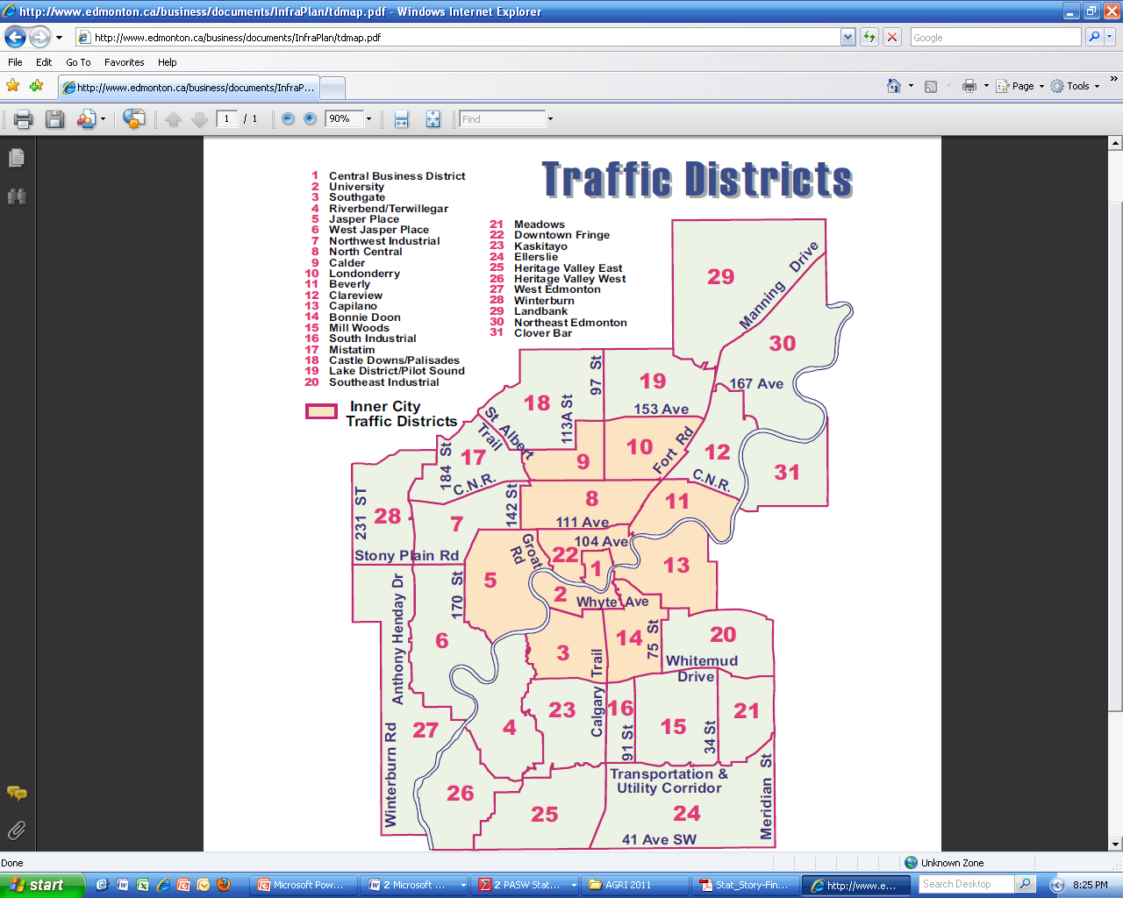
Edmonton inner city: 60% of Aboriginals live here
Our sample was 63%
Notes:
60% of Aboriginal people in Edmonton live in the 11 districts designated ‘inner city’ by the City of Edmonton
Our sample – 63% lived in the inner city.

Slide 6
Present sample vs Canadian urban Aboriginal population
 | Present sample | Urban Aboriginal popul (Canada)
Female % | 59% | 56%
Age 25-44 yrs | 53% | 49%
Married/common law | 40% | 51%
≥ High school | 55% | 59%
University/college | 20% | 20%
Income <$20 000 | 46% | 47%

Slide 7
What is the extent of the problem?

Slide 8
Edmonton Aboriginal Study
Gambling Categories (N = 361)
1 in 3 urban Aboriginal
peoples in Edmonton
were problem gamblers
Notes:
Mean age gambling problem started – 24 yrs

Slide 9
Pilot Study 2008
Aboriginal university students (N = 60)
1 in 4 Aboriginal university students were problem
gamblers
Notes:
Little difference between those identifying as First Nation (75% of sample) or Metis (25% of sample)

Slide 10
PSGI Categories
Gender Differences
Males (36% PG)
Females (31% PG)

Slide 11
PSGI Categories
Group Differences
First Nations (PG = 34%)
N = 270
Metis (PG = 34%)
N = 76

Slide 12
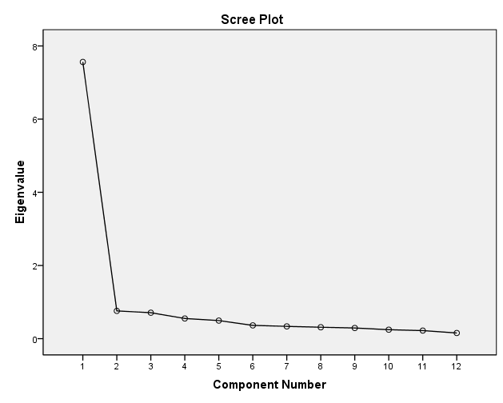
Edmonton Aboriginal Study
Factor analysis of 9-item PSGI

Slide 13
Gambling Involvement (full sample)
%

Slide 14
Gambling Involvement (PGs only)
N = 118
%

Slide 15
How is problem gambling impacting urban Aboriginal people?
Edmonton Aboriginal Study

Slide 16
Edmonton Aboriginal Study
Problem Gambling Impacts
Past 12 months | Non PGs n = 243 | PGs n = 118
Severely depressed (2+weeks) due to finances | 33% | 50%
12 month suicide attempt (lifetime) | 6% (28%) | 12% (24%)
Prescription drug dependence | 20% | 31%
Sought help for PG | 1% | 18%
Notes:
Treatment – gamblers anonymous, treatment centres, counsellors most common way they sought help.
Qualitative data suggest urban Aboriginals are engaging in multiple addictive behaviours to address an underlying social void.

Slide 17
Impacts on Social Relationships
30% of sample believed their parent had a current gambling problem. Almost all had a relative or friend with PG.
“I feel powerless to help.”
“Its stressful because they ask you for money and you have to say no.”
Qualitative Themes
Gambling is an escape from feelings of social alienation – but creates a downward spiral of further social alienation
Gambling distorts people's beliefs that money is more important than family, community and self.
Reduced social cohesion in the urban Aboriginal community because of PG.

Slide 18
Impacts on Children
30% of sample negatively impacted by parent’s gambling as a child.
Themes: Impact of gambling on an already financially strained household, parental absence from home
  “My mother would spend her entire pay check without paying bills or buying groceries. It was my mom who first made me come with her to gamble on VLTs. After my first win, I always wanted to gamble when I had money.”
  “My father was addicted to bingo. Bingo took him and his time away.”
  “My mother was not at home most of the time because of gambling.”

Slide 19
Why are urban Aboriginal people experiencing gambling problems?
Edmonton Aboriginal Study

Slide 20
Edmonton Aboriginal Study
Why do you gamble?
Select all that apply |  | Mean PSGI Score
Escape | 18% | 8
Fun | 46% | 5
Win $$ | 49% | 5
Socialize | 36% | 3
Other | 18% | 2
Notes:
3 out of 4 problem gamblers said they gambled to escape

Slide 21
Edmonton Aboriginal Study
(problem gamblers only)
What are they
escaping from?

Slide 22
Social Determinants Perspective
  Current poverty
  % of life course spent in poverty
  Current unemployment
  Negative residential school experiences
  Physical abuse in childhood
  Sexual abuse in childhood
  Level of racism experienced in past 12 months
  Level of racism experienced as a child
  Low social support

Slide 23
Comment by participant
“There is still a lot of racism and apathy in Alberta, Canada. Negative treatment from white society happens almost daily on some level. It reminds that I am an Aboriginal and not a white Canadian. I often feel like I walk two paths; the Native way – my culture vs. the Canadian way – dominant culture.”

Slide 24
How much racism do urban
Aboriginal people experience?
Group | N | Mean Situations (0-9) | Mean Freq Score (0-45)
Aboriginal university students | 60 | 4 | 13
Urban Aboriginals | 381 | 3 | 10
US African Americans | 156 | 2 | 7
US Latino Americans | 300 | 1 | 3
US Data: Kreiger, Smith, Naishadham, et al. (2005)

Slide 25
Racial discrimination in public places in past yr

Slide 26
Racism in
Public Urban Spaces
Aboriginal Women
“Almost all the time if I am at a bus stop people look at me as if I were a hooker. It makes me feel like I can’t go anywhere without that label.”
Aboriginal Men
“Before I couldn’t even walk down the street without someone yelling ‘go back to where you come from f***ing Indian’ or being stared down by cops. It is unsafe for us sometimes.”

Slide 27
Racial discrimination at school in past yr
“Elementary I got into fights about ‘Indianness’. Secondary [school] was name calling and racial slurs. University is ‘invisible’ racial discrimination to outright racial slurs.”

Slide 28
Racial discrimination in stores and restaurants in past yr
[At an optometrist’s office]: “’Oh we don’t cover Indians here’… assuming I can’t afford glasses off the shelf.”

Slide 29
Impacts of Racism
“Being a minority is like being in a cage with no help. Sometimes its better to accept than fight.”
“Although it happens at least once a month, I am always caught off guard.”
“It makes it difficult to concentrate and want to succeed.”
“We are all not drunks and addicts and gamblers and we don’t go through life on welfare and education-less! We are people. I sometimes feel so stereotyped by this.”

Slide 30
How do social circumstances lead to addiction?
Negative social experiences
Biologic reactions
Emotional response
Addiction
Trying to cope
- drinking
- smoking
- gambling
- drug use
Notes:
-incautious lifestyles – people harm themselves and their children by their bad behaviour – personal characteristics govern behaviour

Slide 31
Edmonton
Aboriginal
Study
Gambling to Escape
Mediation
explained = 25%
β = .18
β = .32
Level of Racism
Problem Gambling Score
β = .17
After adjustment for gambling to escape: β = .12
Adjusted for age, gender, education, income, Aboriginal status, frequency of visits to First Nations communities
Notes:
Adjusted for age, gender, education, life course poverty, freq visits to FN, Status or non status Aboriginal

Slide 32
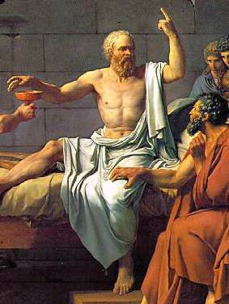
Social determinants of PG
These ideas are not new.
More than 24 centuries ago Socrates argued individuals who have a secure role in a welcoming and balanced society can easily resist master passions (i.e., addictions).
Conversely, societies that exclude and denigrate groups of individuals predictably generate epidemic addictions in these groups as individuals strive to endure these experiences in the most adaptive ways they can, within the limits of their knowledge.

Slide 33
Conclusions
What is the extent of the problem?
This study suggests problem gambling is very high among urban Aboriginal peoples – in this study 33% were PG
How is PG impacting this population?
Double the rate of past year suicide attempts, damage to social relationships, remain in a cycle of poverty
Why is this population experiencing high PG?
75% gambling to escape
Experience high levels of racism in Edmonton – many gambling excessively to deal with it

Slide 34
What can be done?
Examine the root cause of the problem: “I actually wouldn't call smoking recreational just as I wouldn't call playing bingo recreational. They are addictions used by survivors to avoid intense feelings.
Reclaim Aboriginal identity: “It's important to find meaning in something greater than yourself and to connect with your identity to fill the hole that gambling tries to fill.”
Address the social determinants of health

Slide 35


Thank you cheryl.currie@ualberta.ca
This research is supported by:

