Slide 1
Assessing Discovery
University of Calgary
User Experience Team
Susan Beatty | Helen Clarke
Saundra Lipton | Andrew Pasterfield
Tim Au Yeung | Rhiannon Jones
Laura Koltutsky | Catelynne Sahadath
Paul Pival | David Brown *
Kathy Drewes
October 25th Netspeed 2013
Notes:
Team has been together since 2011

Slide 2
Discovery User Experience Team
Includes members from Systems, Public Services, Metadata
  Reiterative design
  User profiles and understanding
  Advisory to Discovery Systems unit
Notes:
Team has been working together, with some changes in membership since 2010
Is not a research group, our goal is to apply quick, effective processes to assess the users experience of discovery
We believe that continuous, light weight assessment supports agile system development
We aren’t looking for one study that answers all our questions, rather we hope to accumulate knowledge and experience about users—and editorial/design process
Projects to date have used log files, quick in-person surveys, personas, this last round we experimented with a talk aloud study
Not design by committee, we are advisory to the Discovery Unit

Slide 3
Outline of presentation
Introduction to the Unified Search Interface
Log File and User Survey
Talk aloud Survey
Redesign
Notes:
In this session we’ll discuss our latest project which was to review the UofC’s new Unified Search Interface
Rational and process for developing the USI
Log files
-User Survey
Talk aloud
How this information was used in the Redesign that took place this summer

Slide 4
Features of USI
Minimize initial decision making by user
  Single Search Box
Maximize options in results display
  Differentiation by format (e.g., books, articles, media)
  Intelligent linking based on Search Terms
  Easily navigate to more in-depth/specialized tools
Discovery as learning
Notes:
Why the Unified Search Interface (USI)
Discovery Strategy called for a focus on Summon
Inspired by other sites, notably North Carolina State University, Umich to overcome some basic issues with Discovery Tools
non-differentiation of results
Database recommender
Easily moving from discovery layer to more in-depth tools and to services
Discovery isn’t just finding, its about learning to explore, differentiate, assess, it is a key part of learning about a subject
Andrew Pasterfield did much of the programming work behind building our USI, he’ll discuss his process next

Slide 5
Unified Search Interface
Technical Details

Slide 6
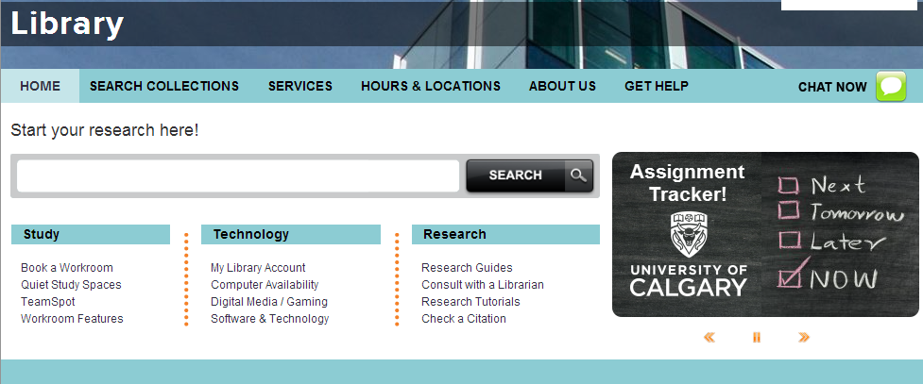
USI: Single Search Box
Notes:
This is the library’s landing page – you’ll notice we provide a single search box

Slide 7
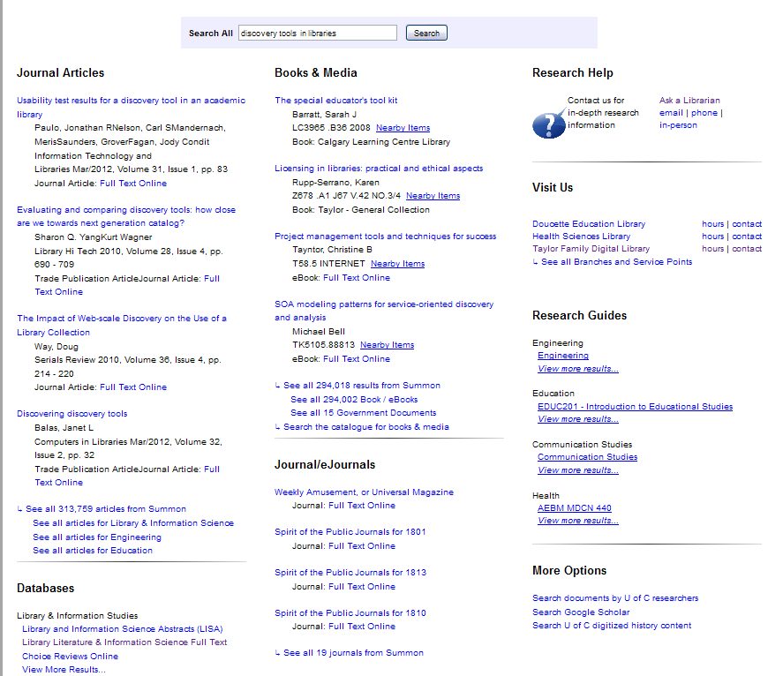
USI: Bento Box Layout
Primary layout is by format
Right side presents service and help information
Links to more results are sensitive to topic and format
Notes:
Primary layout is by format Right side presents service and help information

Slide 8
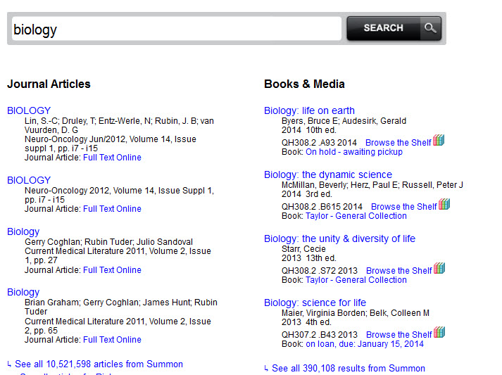
USI Modules
Notes:
The USI results display is comprised of Modules – here you are seeing 2 modules

Slide 9
USI Modules
Summon Based Modules
1. Articles
2. Books
3. Journals
In House Modules
1. Research Databases
2. Research Guides
3. Research Help
4. More options
5. Branches
6. Web pages
7. Best Bets
Notes:
Upon original release we used 10 modules With some of our in house modules, we re-purposed the data from the Summon API to help construct these other modules

Slide 10
Three Programming Features
Sub-setting Summon results into content types
Leveraging Summon subject facets to create intelligent guidance
Designed with assessment in mind

Slide 11
The Summon API
How – do we use it?
FACETS: The Summon API provides facets
Query: Biology
<?xml version="1.0" encoding="UTF-8"?>
...
<facetFields>
<facetField>
<facetCount value="biology" count="6111524"/>
<facetCount value="medicine" count="1985495"/>
<facetCount value="chemistry" count="1555306"/>
</facetField>
</facetFields>
Notes:
Embedded facets provide the disciplines related to the search A query of biology yields disciplines of biology, medicine, chemistry as determined by Summon

Slide 12
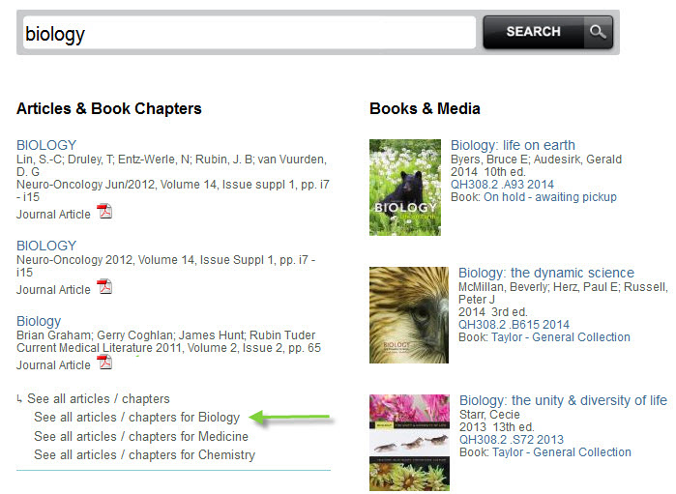
Disciplines in the Articles Module
Notes:
Here is another way we present the disciplines provided by Summon so the patron can do more granular searching

Slide 13
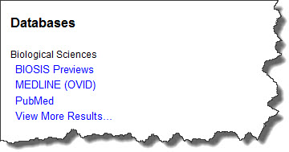
Disciplines in the Research Databases
Notes:
Another example - Notice we call Biology – Biological Sciences

Slide 14
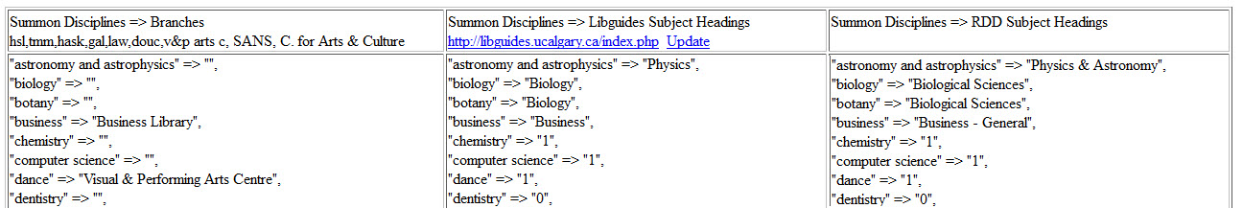
Mapping
Summon Discipline: Biology
but…
U of C Library: Biological Sciences
Notes:
The Summon Discipline is Biology but {TAP slide} we call it Biological Sciences… how did we overcome this? By creating a mapping grid These are 3 in house modules

Slide 15
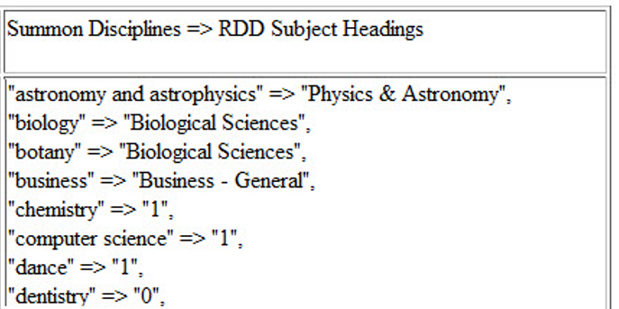
Mapping
Notes:
Looking at our research databases mapping – on the left is Summon

Slide 16
Mapping
Notes:
To re-iterate

Slide 17
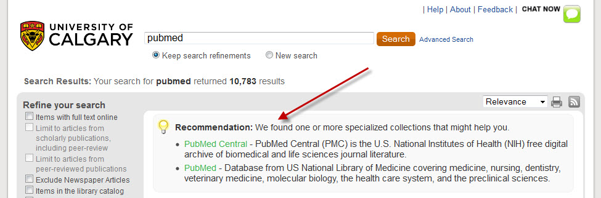
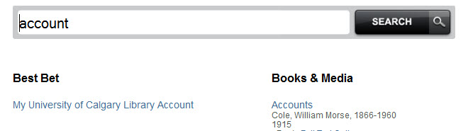
Best Bets
Notes:
Another in house module – is Best Bets - A chance to promote local items or provide links to our services that a patron is looking for

Slide 18
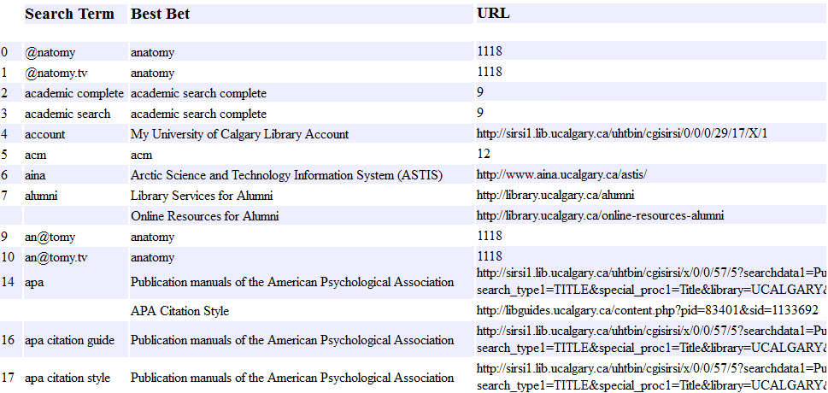
Best Bets – Back End
Notes:
A chance to promote local items or provide links to our services that patron’s are looking for. Of note: Helps with spelling variations It allows for specific URLs or what I’ve tied it into our Research Database system so that it will bring back the appropriate Title, URL and abstract – without having to keep a duplicate copy of the RDD in this system.

Slide 19
Technical Specs.
Done via ajax – using jquery & XML transforms
Search Model:
index.php → ajax → php processing → api → xml → filter xml → returns results
Query.js
$.ajax({
type: "POST",
url: "submit.php",
async: true,
dataType: "html",
data: "query="+query+"&type=booksmedia"
}).done(function(html){
$("#2a").html(html);
});
Notes:
Each module calls the same script but depending on parameter passed – that determines which module loads

Slide 20
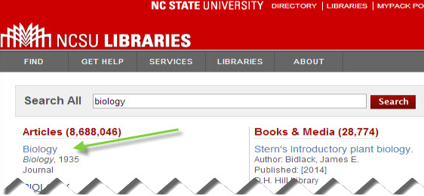
Logs
NCSU uses a proxy to log their clicks
Notes:
NCSU was an inspiration for our USI. I saw how they handled click tracking AND felt I could improve on it. Their proxying script is noticeable in the URL – cutting off the destination

Slide 21
How USI Logging is done
Uses ajax
Custom jquery function
$("a").live('click',function (event) {
Attributes embedded in the <a href ..> tag
Data Parameters: id, title, link, query
all log data exists in the <a href > tag

Slide 22
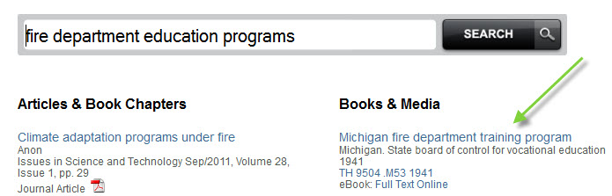
Sample log
[1/Oct/2013:14:54:00]|fire department education programs|summonBooks-1|Michigan fire department training program| http://ucalgary.sum
[1/Oct/2013:14:52:30]|web of science|bestbet-1|BestBet-Web of Science| http://ezproxy.lib.ucalgary.ca/login?url=http://

Slide 23
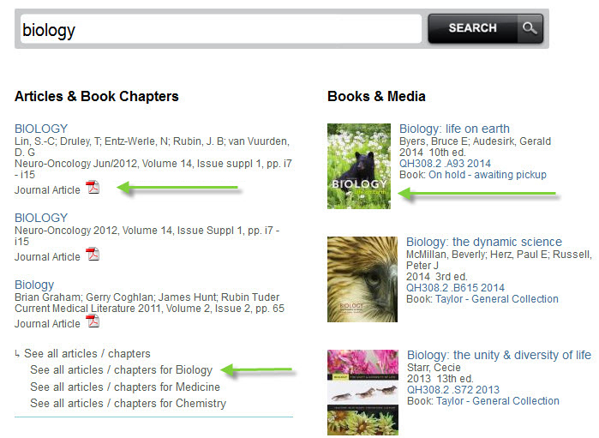
[22/Aug/2013:10:38:12]|oracle books|summonBooks-CoverImage-1|Oracle essentials |http://ucalgary.summon..
[23/Aug/2013:08:38:01]|Next-generation genomics…|summon-Articles-fullText-1|Next-generation genomics…|http://ucalgar..
[18/Sep/2013:03:42:48]|giftedness|summon-Articles-ViewMore-education||http://ucalgary.summo..

Slide 24
Launch of V 1.0
launched on September 7, 2012
First Query:
9:43:10 AM
Dealing with cultural diversity: the endorsement of societal models among ethnic minority and majority youth in the Netherlands

Slide 25
User Experience Testing
Data Sources | Questions
Log Files User Survey Talk aloud Study | Usability? Impact on process? Known item and subject searching
Notes:
Our testing of the USI employed three data sources and explored the usefulness and popularity of the different modules
Usability…were there specific issues with layout, language, or functionality that made the USI difficult to use
Effectiveness…what impact did the USI have on users discovery process, how was it helpful, how could it be improved
Type of searching….were the issues relating to know item vs subject searching, were these problems cognitive (result of user confusion with the display or how to search) or functional (the USI was misleading or the design could be improved)

Slide 26
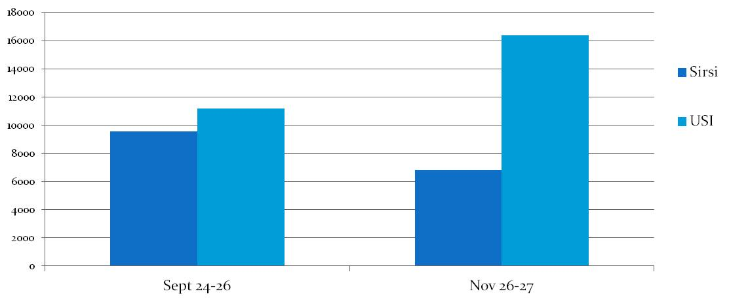
Logs: catalogue and USI
Catalogue and USI clicks on books/articles
Notes:
Collected data for 3 busiest days in September and November after introduction.
Demonstrated that people weren’t rejecting the USI. Despite outcry from folks who missed the prominent link to the catalogue.

Slide 27
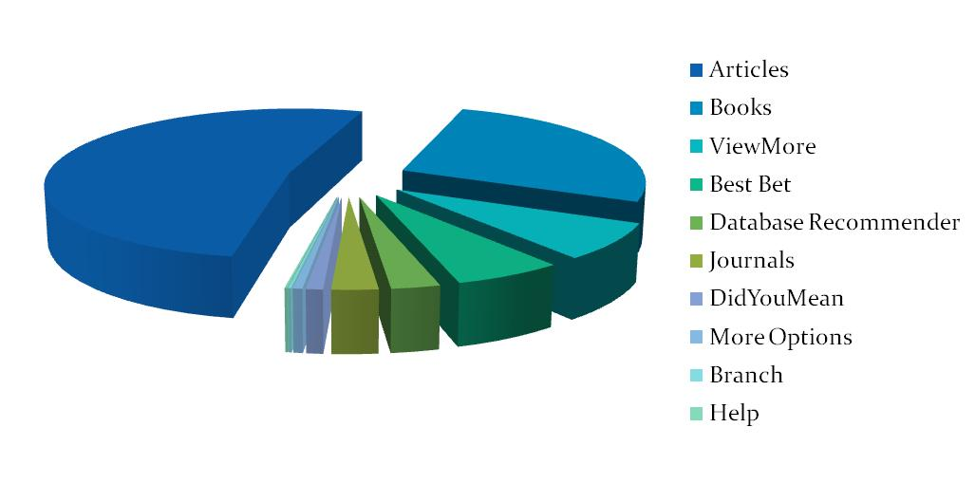
Log: USI elements clicks
Log data quickly identified areas of the USI with high clicks versus low clicks
Notes:
Log data was extremely detailed and allowed us to identify usage of each element of the display
We decided to focus our next work on modules that were received little or no use

Slide 28
User Survey
49 respondents June 2013
  Recruited in TFDL learning commons
  Rewarded with a doughnut (Jelly Modern)
Survey—series of set questions
  Search habits
  USI acceptance
  Targeted feedback on low use elements
Notes:
Basic demographics and where generally begin searching
Discuss experience with Bento Box, parts they would use, parts they would not use
Asked specifically about parts that showed low use in the log files, probing to see if they understood the purpose, but did not find of use, or if they would have used if our explanation/presentation had been better

Slide 29
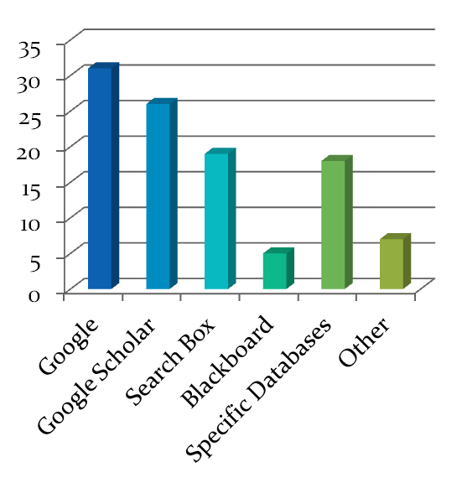
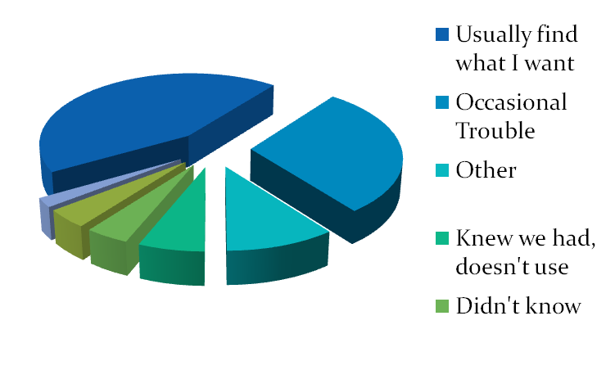
Survey :: Profile of Respondents (49)
Undergraduates (39)
Monthly to Weekly Users of Search Box (33)
All disciplinary areas
Starting Points
Satisfaction
Notes:
Kiosk set up in the Learning Commons of the TFDL to ask students a set of questions and give comments on the USI.
Jelly Modern Doughnuts were used to reward students for participating.
Undergraduates with moderate use of the search box, good to moderate levels of satisfaction, but certainly there were folks who were unaware or had problems, however only 3 reported finding the interface frustrating.
Search Box was a strong starting point, but Google/Google Scholar were not surprising winners.
Note we did not offer the catalogue as an option as we have found it quite hard to know what the students thing we mean when we use the term catalogue.
Most use Search Box on a monthly (18) or weekly (15) basis
Most were undergrads (40)
Area of study varied with 25 in the sciences and 18 in the social sciences
20 responded that they usually found what they wanted using the Search Box, 14 reported occasional trouble, 3 reported the Search Box was frustrating
Usual starting points were Google (31), Google Scholar (26), Search Box (19) and Specific Databases (18)

Slide 30
Survey:: Use of the Bento Box (49)
Element | Would Use | Would Not Use | Log File Count
Journal Articles | 43 | 3 | 14,435
Books & Media | 32 | 10 | 7,373
Databases | 18 | 8 | 761
Library Web Pages | 5 | 9 | n/a
Journals | 4 | 4 | 720
Theses & Diss | 0 | 19 | 0
Visit Us | 0 | 9 | 50
Research Help | 0 | 16 | 40
Research Guides | 0 | 8 | 0
Notes:
Question: What 3 parts of the display would you use, what 3 parts wouldn’t you use?
Matched up with log file counts to show consistency between the survey and the logs

Slide 31
Acceptance and Understanding
 | Nearby Items | Research Help | Visit Us | Research Guides | Summon | UC Researcher | Google Scholar | Digitized History
Use | 12 | 11 | 5 | 9 | 5 | 5 | 5 | 5
Not Use | 29 | 36 | 41 | 38 | 36 | 37 | 38 | 34
Understand | 27 | 32 | 32 | 19 | 15 | 35 | 25 | 4
Not Understand | 20 | 11 | 11 | 27 | 24 | 4 | 15 | 36
Notes:
Asked specifically about modules that were receiving low use.
Here we were trying to understand if low use was a result of poor understanding, disinterest or both.
We recorded the comments in brief, hoping this would give us some insight into the source of misunderstanding or decisions to use/not use
Much of this data found its way into the redesign—more on this later
Laura and Susan will present on the talk aloud survey.

Slide 32
Talk Aloud Survey

Slide 33
Study
Recruited 8 volunteers, offered $25 gift card
Outline 3 search tasks
  Find resources on a topic
  Find a journal article (known item search)
  Find a book chapter ( known item search)
Process
  “As you work through each task talk about what you are doing, why and what you are thinking.”
  Students were observed, prompted to answer questions such as ‘what would you normally do?” but not told what is the “correct” way
Demographics
  8 students: 2 grad and 6 undergrad ( 7 science/engineering and 1 social science)
Notes:
Citations were purposely difficult and complicated.
Most usually started with Google or Google Scholar but for this study starting point was proscribed as the big search box.

Slide 34
Analysis process
Gather data – “talk aloud method” using Open Hallway
First, review video and map actions into predetermined categories ( common tabulation sheet)
Second, tabulate and sort data according to action, place, purpose, comments
Third, further tabulate purpose / place to determine how discovery interfaces and tools are used
Notes:
Action – what were they doing
Place – where were they doing it
Purpose – why were they doing it
Comments – any comment made by student or observer relevant to the action
What we were not doing:
Trying to establish the path of discovery for each type of task

Slide 35
Purpose/place
Purpose terminology – used set terms
  Sources:
    Ellis’s (1989) model of scholarly information seeking behaviour
    Meho and Tibbo (2003) update for electronic information sources

Slide 36
Purpose Term Definitions
Starting – activities surrounding the initial search for information
Browsing – semi-directed searching
Differentiating – filtering material, deciding what should be examined more closely
Accessing – locating and retrieving information
Verifying – affirming correctness of information
Managing – organizing information for later retrieval
Extracting – Working through sources systematically
Fulfillment (electronic/print)- final selection
Notes:
While these terms were used to describe faculty research behaviour and not necessarily discovery by students they do manage to describe the purpose that the students had in mind

Slide 37
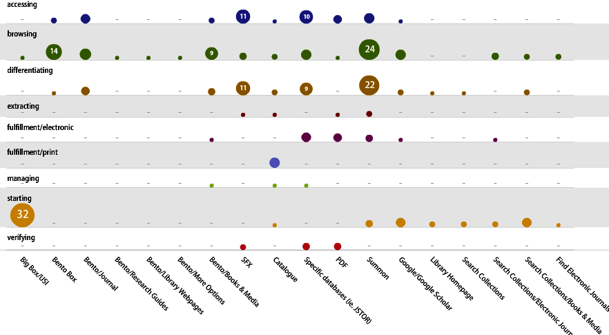
Frequency and Distribution of Place/Purpose
Notes:
Scattergram
Looking down you can see the variety of purpose ( ie what was the reason for being at a particular site
Although we only asked them to start at the big box, there was a return to the big box for some, plus starting at other places
The most frequent purpose and most broadly based was browsing. It seemed that when if they did not know or were unsure they would go back and forth looking at different places.
Differentiating ( ie checking it out) was the next most broadly based purpose. There was often a back and forth between the two purposes.
Lastly accessing would be the next step often to check out at a deeper level.
We have not analyzed each participant’s path, which likely will give us more insight into the decision-making process of the searcher.

Slide 38
Observations
Students do not think like us
  Searching is exploratory and reiterative
  confident of their skills and generally persistent in searching
  Limited “tools” to work with
Design does work, but
  Users do not necessarily distinguish USI modules based on task
  Surprising use of SFX, albeit comments lead us to believe that most do not understand it
Looking at uses of purpose/modules gives us some guidance on understanding how users approach discovery but there is more research to be done
Notes:
Usability of design?
Need to explore data further and discuss with larger group, eg. How does design impact instruction and learning?
Impact of design on user’s process?
Support for known item and exploratory searching?

Slide 39
References
Ellis, D.A. (1989) A behavioral approach to information retrieval system design. Journal of Documentation, 45, 171-212.
Meho, Lockman I. and Helen R. Tibbo. (2003) Modelling the information seeking behavior of Social Scientists: Ellis’s study revisited. Journal of the American Society for Information Science and Technology, 54 (6), 570-587.

Slide 40
Redesign USI 2.0
Notes:
Redesign was informed by a variety of sources
-user experience testing
New features in Summon
brainstorming meeting with user experience, public services and discovery systems

Slide 41
USI Assessment
Successes
Changes
Lets students effectively use Google skills
Disciplinary faceting
Productive feedback
Database recommender
Improved display
Background information
Deleted underutilized modules
Promoted modules in display
Merged book chapters with articles
Notes:
Summarize our impressions after working through the data to this point.

Slide 42
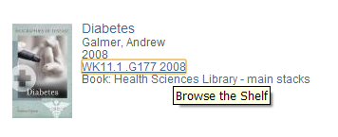
Redesign: Nearby Items
Allows us to present a browsing experience for users who feel this is important
User interest was low
Keep functionality but less intrusive
Notes:
27 did seem to understand related to fining books on a similar topic
Negatives were not clearly articulated, but seemed to relate to the infrequency with which were searching for books on a topic, and preference for online

Slide 43
Redesign Help
Much of the functionality included to incorporate user help/guidance into search was deleted in the redesign
LibGuides
Intelligent link to Libguides
Not suited to search process
Research Help
Link to chat / ask a question
Redundant
Visit Us
Intelligent link based on search
Redundant
Notes:
Libguides
Intelligent link based on search terms, however, Libguides at UofC are designed more to support library instruction and they did not fit well into user expectations of search, have deleted for now, but are still interested in revisiting if we design a more uniform introductory set of Libguides
- 20 thought this would be help on how to do more general tasks—citing, searching, writing, etc.
Research Help
Redundant, already on the page elsewhere
Received some comments that users were uncertain of chat—who was on the other side, what types of questions should they ask, was chat active….have changed chat icon to be green when active
Students were more positive about chat, however 11 noted a preference to talk to a person when needing help
Would use the main chat link
Visit Us
Intelligent linking to branch libraries based on search terms, redundant, users preferred to use Google or Hours and Locations link on web page
At least 11 respondents understood link to search, but this didn’t affect interest in using the link
41 said would not use, fining information via the web page or google

Slide 44
Redesign Continue Search
Original Bento Box included links that would carry search terms over into different search platforms. In the redesign these were either deleted or promoted.
Summon
Not understood
Promoted to top right of page
Repository
Understood but unlikely to use
Deleted
Google Scholar
Did not understand advantage of this link
Promoted to top right of page
Digital Archives
Did not understand and were unlikely to use
Deleted
Notes:
Summon
This link would take users directly into the Summon interface, Summon does not have name recognition among users, however many recognized it and even commented positively when they were shown how the link worked.
21 indicated some understanding of Summon, but didn’t seem to have a strategy to get there
Promoted to see if we get more use, also to keep the Summon interface familiar to users as we may eventually migrate to the Summon native interface
Repository
Students understood, but were very unlikely to use. We still want to promote the repository, but need to find another way to do this.
35 understood what this was but only 5 would use
Google Scholar
Clear enthusiasm for GS, but students did not understand the advantage of this link, already configured for University of Calgary SFX and authentication, promoted to see if we can get more use, also some indication that authentication is a persistent issue that we may need to address
UofC digitized history
Worst label of all time…created considerable confusion ranging from thinking this was there search history to this was the history of the UofC
Still even after explanation 34 still said they would not use, and 36 did not understand at onset
Need to find a different way to promote

Slide 45

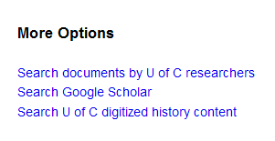
Redesign Continue Search
Original Bento Box included links that would carry search terms over into different search platforms. In the redesign these were either deleted or promoted.
Notes:
Summon
This link would take users directly into the Summon interface, Summon does not have name recognition among users, however many recognized it and even commented positively when they were shown how the link worked.
21 indicated some understanding of Summon, but didn’t seem to have a strategy to get there
Promoted to see if we get more use, also to keep the Summon interface familiar to users as we may eventually migrate to the Summon native interface
Repository
Students understood, but were very unlikely to use. We still want to promote the repository, but need to find another way to do this.
35 understood what this was but only 5 would use
Google Scholar
Clear enthusiasm for GS, but students did not understand the advantage of this link, already configured for University of Calgary SFX and authentication, promoted to see if we can get more use, also some indication that authentication is a persistent issue that we may need to address
UofC digitized history
Worst label of all time…created considerable confusion ranging from thinking this was there search history to this was the history of the UofC
Still even after explanation 34 still said they would not use, and 36 did not understand at onset
Need to find a different way to promote

Slide 46
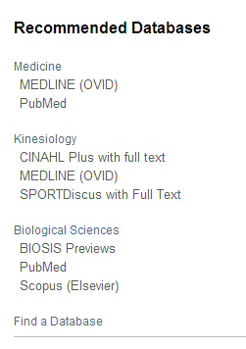
Redesign: Database Recommender
Search : diabetes
Student awareness of databases but tended to only know a few by name
In-house database rankings were not uniformly applied
Re-ranked to uniformly recommend top three

Slide 47
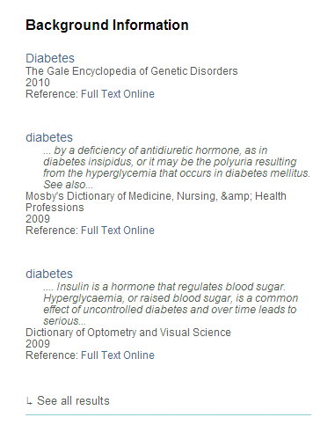
Redesign: Background Information
Students looked for overviews when subject searching.
Relied on Google and Wikipedia.
Leveraged off the “reference” facet to create a background information module.
Notes:
Early days in assessing the talkaloud, but viewing students doing subject searching helped lead to the development of this option.

Slide 48
Conclusions
USI is successful for discovery
All three study types were in broad agreement
Log Files and User Surveys were sufficient for ongoing “editorial” testing
Talk aloud are time intensive, best used to build user profiles
USI is not the first or only tool people will use

Slide 49
Next Steps
Continue to develop USI and monitor via log files and user surveys
Explore different user profiles and cognitive processes
Explore use cases for the USI
Optimize discovery in other search tools, e.g., Google, Google Scholar, Wikipedia, Archive Grid etc.
Notes:
User Experience group is still going strong, we are particularly interested in developing our user profiles/personas to include a wider range of user types…particularly researchers/grad students
On the discovery front, while the USI continues to be a focus for development and refinement, the latest round of testing confirmed the importance of pushing discovery out to where our users are, Discovery Systems will be making this a priority in the upcoming 12-18 months.
This will provide the User Experience group with a whole new batch of options to assess.

Slide 50
Contacts library.ucalgary.ca
Susan Beatty
  sdbeatty@ucalgary.ca
Helen Clarke
  hclarke@ucalgary.ca
Laura Koltutsky
  ljkoltut@ucalgary.ca
Andrew Pasterfield
  ampaster@ucalgary.ca
Notes:
If you have questions we don’t have time for today, please get in touch. We’ve also provided index cards for you to note any questions and your contact information. We will get back to you.

